Slide 1
Presentation on Book I of Illiad by Homer
Ujjwal Biswas
Assistant Professor
Department of English
Semester – IV
Session-2019-20
Khatra Adibasi Mahavidyalaya

Slide 2
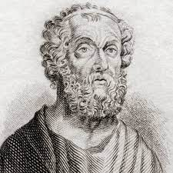
Homer
There is little knowledge about the life of Homer
The author is credited with composition of The Iliad and The Odyssey
He is possibly the greatest poet of the ancient world.
Historians place his birth sometime around 750 BC and assumption that he was born and dwelt in or near Chios

Slide 3
Important Characters
Achilles: The son of Peleus and the sea-nymph Thetis. The greatest warrior in The Iliad
Agamemnon (also called “Atrides”): King of Mycenae and leader of the Achaean army; brother of King Menelaus of Sparta
Calchas: An important soothsayer. His recognition of the reason of the plague ravaging the Achaean army in Book 1 leads unintentionally to the fissure between Agamemnon and Achilles that occupies the first nineteen books of The Iliad.

Slide 4
Characteristics of Epic Poem
Aristotle, in his Poetics, discusses the salient features of an epic:
1. It is a narrative poem written in heroic hexa-metre.
2. Its length is considerable.
3. It has four constituent parts namely plot , character, thought, & diction.
4. Epic encompasses the life of an entire period and deals with an action that determines the fortunes or destiny of a nation.
5. The marvellous has a function in epic.
6. It is episodic

Slide 5
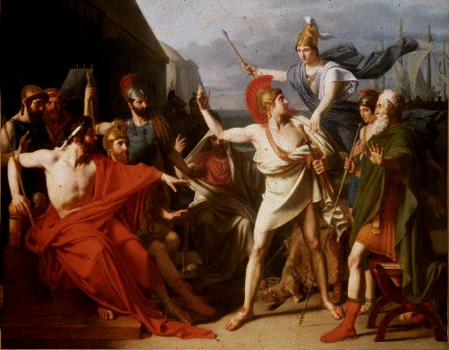
Central Issues
Fate
Kleos
Nostos
Heroism
Pride
Wrath or Mēnis
Gods of Greek Religion
Divine Intervention
Timē

Slide 6
Thank You

